Slide 1


Developed by - Pranali Patyane

Slide 2
Contents
Objectives
Software Requirement
Admin Module
User Module
Login Result
Future Enhancement
Conclusion
System Flowchart

Slide 3
Objectives
It is an online system through which customers can view available cars , register , login , view profile and book car
Nowadays, most of the people prefer car for their trip
This online car rental system is fully functional and flexible
It save a lot of time and money

Slide 4
Software Requirement
Language
Framework
Database
Software Platform
Visual Studio
Command Prompt
User Interface Design
HTML
CSS
JavaScript
Bootstrap
Python 3.12
Django 4.2.7
sqlite3
API
Rest API
Libraries
Virtualenv
Pillow

Slide 5
Admin Module
Manage Booking (Admin can confirm and cancel booking)
03
View Car Details , Booking Details
02
Manage Cars Details (Add / Edit / Delete)
01
Manage to Contact us Query
04
Admin can also update the page content
05
Admin can update the contact us details
06
Logout

Slide 6
User Module
Search Car
03
View All Cars Details
02
Customer Registration /Login
01
Car Booking
04
View Car Booking History
05
View profile
06
Update His / Her profile
07
Update password (Change / Forgot)
08
Logout

Slide 7
System Flowchart
Start
User
Admin
If registered ?
No
Registration
Yes
Login
No
Is Valid ?
Yes
Is Admin ?
No
User
Add Car Details
Car Search
Update all information
Car Booking
Forgot Password
View booking / Contact details also cancel booking
E-mail received for
Booking confirm/Cancel
Logout
Stop

Slide 8
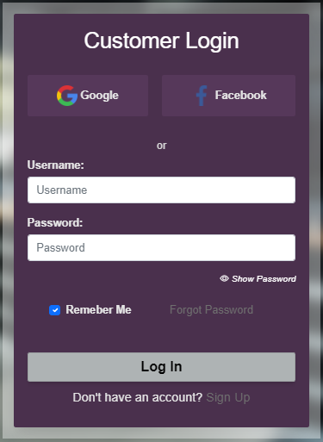
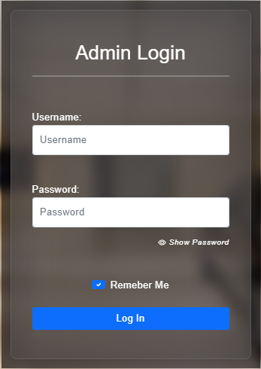
Login Result

Slide 9
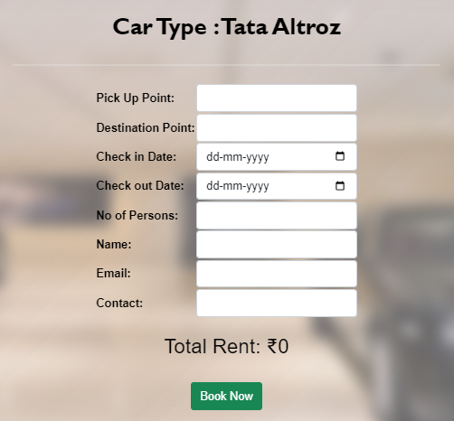
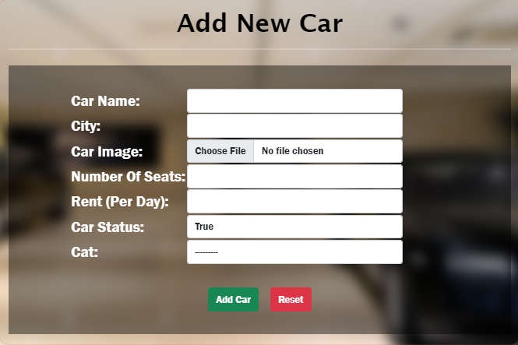
Login Result
Booking Page
Add Car Page

Slide 10
Future Enhancement
We are working to increase automation in the system to increase user experience greatly
A message can be delivered to the respective email inbox of a particular customer informing him/her about his/her completion of registration along with ‘username’ and ‘password’
We are planning to add a new feature i.e. payment method

Slide 11
Conclusion
This software provides an easy-to-use interface to allow for simple access to rental requests and customer information
03
The solution was to provide car rental with an user-friendly web application that would allow for customer to access and use on a wide range of devices : desktops , laptops
02
Main aim is to provide a very user-friendly customer registration system who want to take car for rent
01

Slide 12


